Slide 1
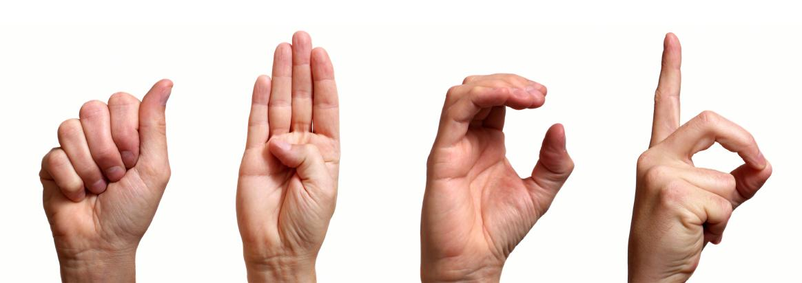

Sign Language Interpreter Glove
Group 24
Christopher Delgado Electrical Engineering
Emmanuel Hernandez Electrical Engineering
Jason Balog Electrical Engineering
Ramon Santana Electrical Engineering

Slide 2
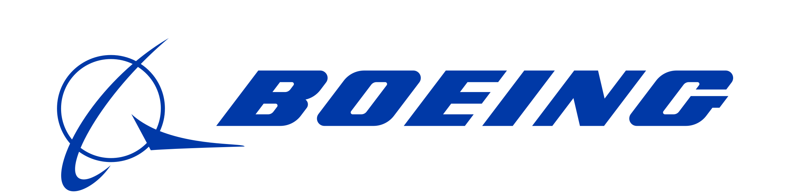

Thank You to our generous sponsors!!!

Slide 3
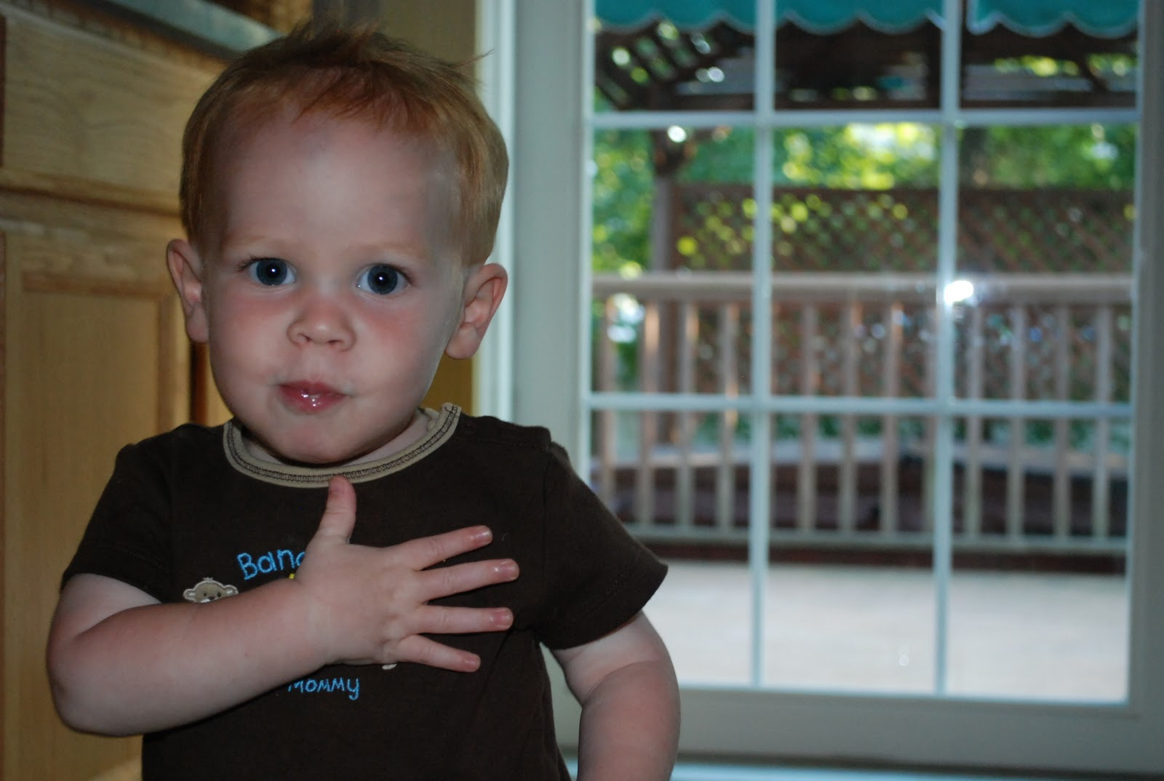

Motivation
The Survey of Income and Program Participation (SIPP) – estimates that about 1,000,000 are functionally deaf in the United States.
The World Health Organization estimates that over 5% of the world’s population – 360 million people – has disabling hearing loss (328 million adults and 32 million children).
The original motivation to pursue this project comes from one of our team members who has experienced the difficulty of communicating with his speech-impaired sister.

Slide 4
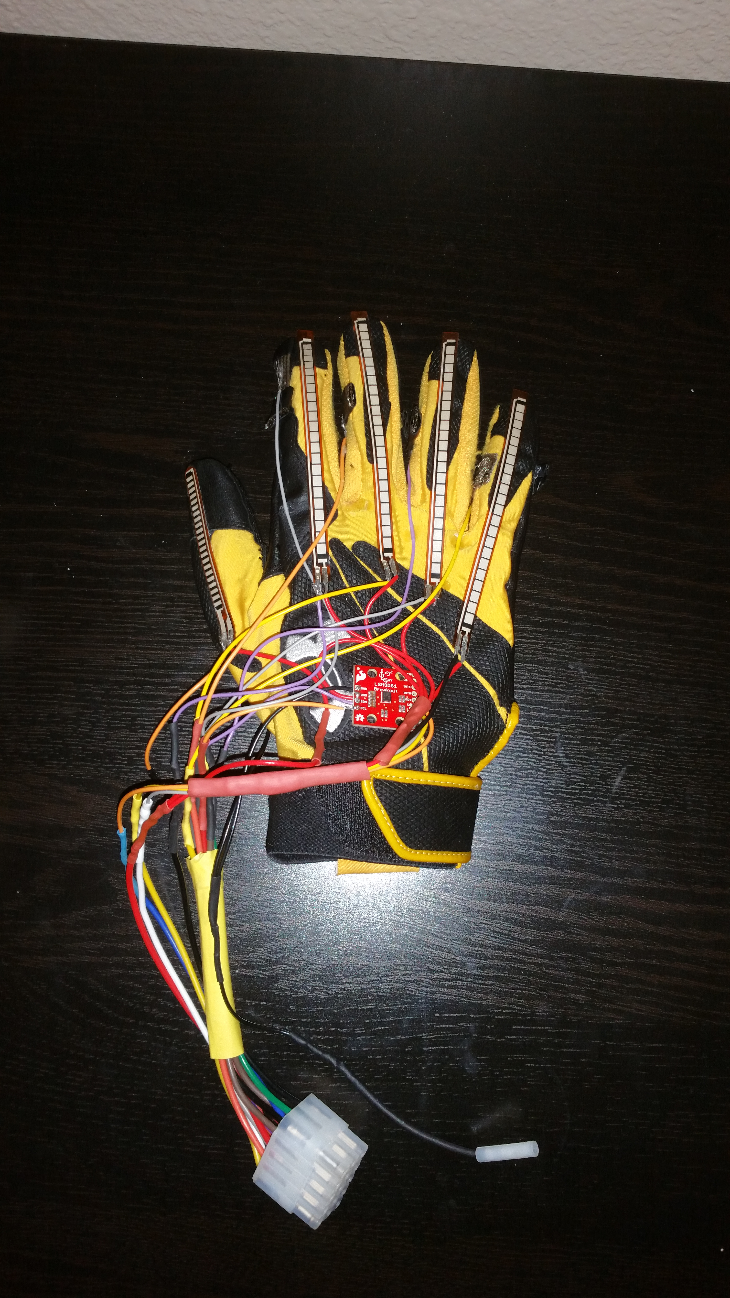
Goals and Objectives
Our objective is to establish communication between a sign language speaker and a non-sign language speaker. Any letter the user signs will be displayed through a user interface where the non ASL-speaker can read the letter. We also want to implement a learning mode, where the user has the option to learn the American Sign Language letters.
Hardware
Flex sensors
Contact sensors
Accelerometer
Gyroscope
MCU: ATMega328
Bluetooth Low Energy
Software
Android Mobile Application

Slide 5
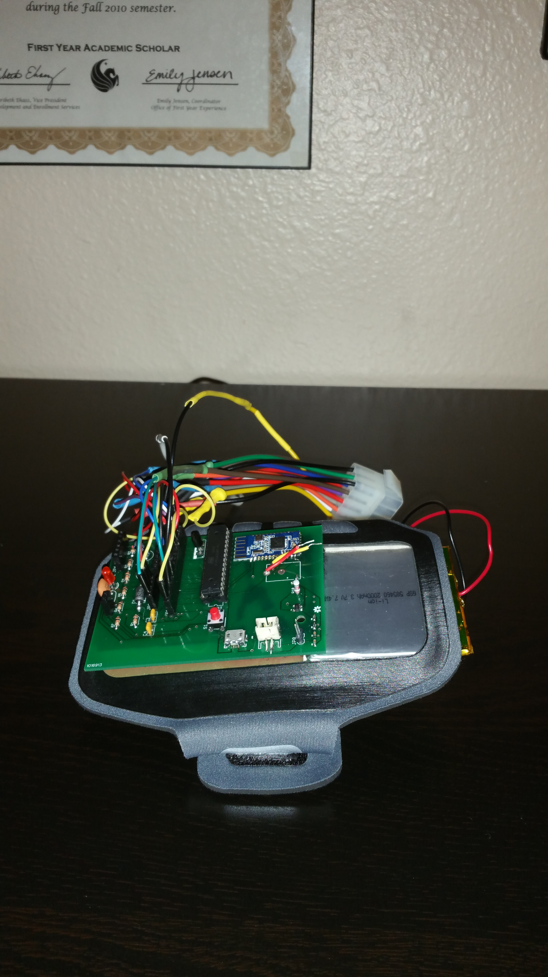
Specifications
Lightweight
Portable
Energy Efficient
Glove Weight | < 1.5 lb.
Lithium Ion Battery | 3.7 V 2000mAh
Battery Life | 13 hours
Specifications Table

Slide 6
Related Standards
IEEE Standards 802.15.1™-2005(Revision of IEEE Std 802.15.1-2002)
-Establishes a communication standard optimized to serve a variety of medical and non-medical applications.
Safety standards for Lithium-ion batteries (International Electrotechnical Commission (IEC) and International Organization for Standardization (ISO).
-IEC 62133-2: safety requirement for portable battery cells
-IEC 62660: batteries for EV/HEV applications
-IEC 61427: secondary cells and batteries for renewable energy storage
Google's Android developers have set up a multitude of standards and qualification on the different aspects of an android application.
-UX-B1: App uses common user interface patterns and conventional use of icons

Slide 7
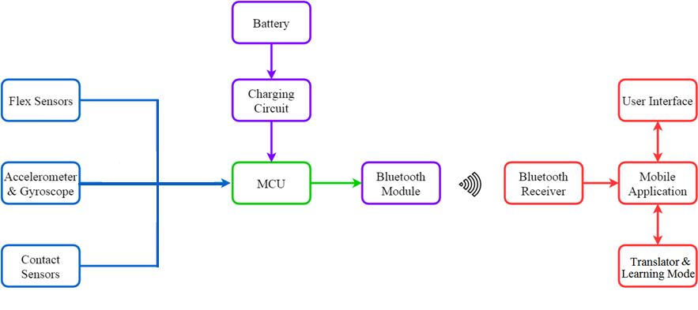
Block Diagram

Slide 8
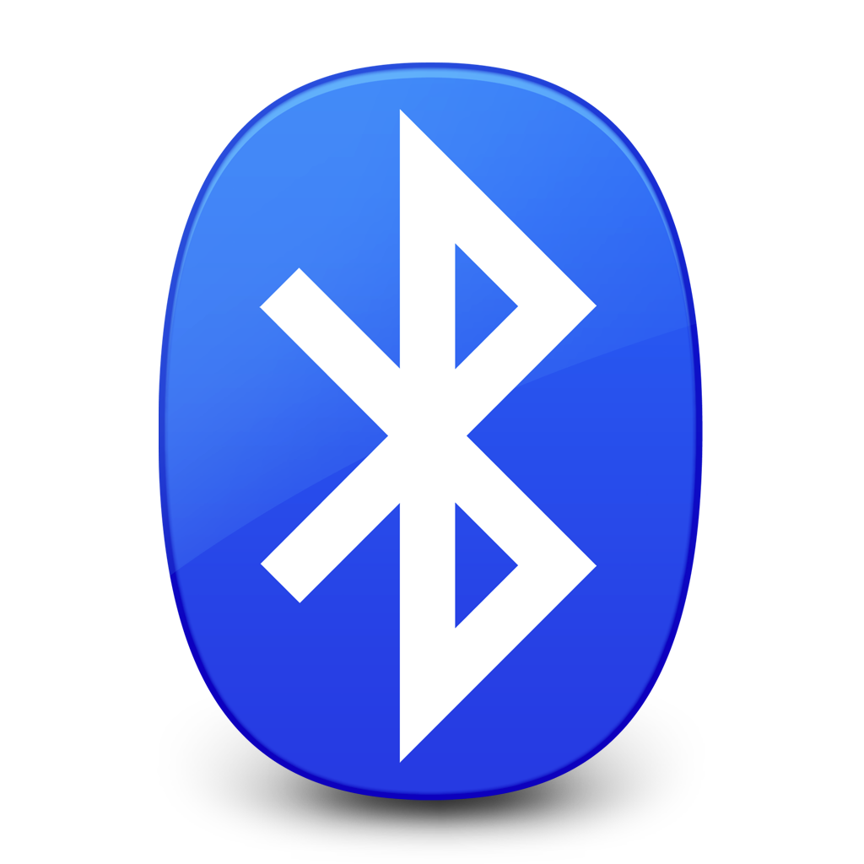
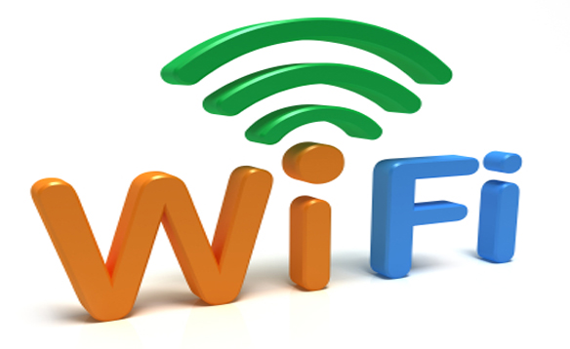
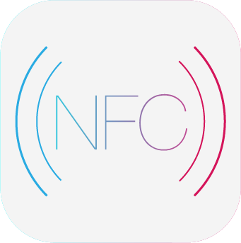
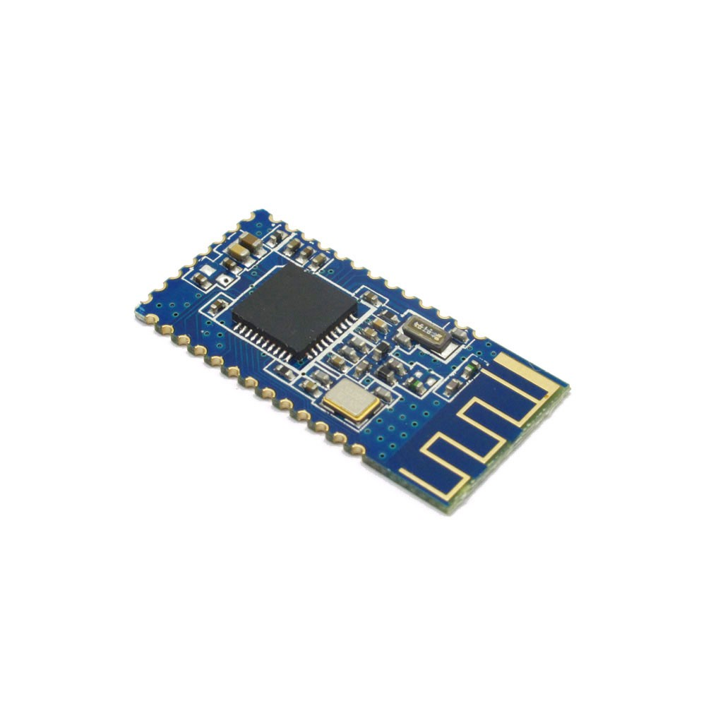
Significant Hardware Decisions - Wireless Communication
 | Bluetooth Low Energy | NFC
Pros: - Security (WPA2) - Range 150-300 feet | Pros: - Range 20-120 feet - Consumes less power than Wi-Fi | Pros: - Consumes less power than Bluetooth Low Energy
Cons: - Needs Router - Consumes lots of Power - Not portable friendly | Cons: - No cons for SLIG ☺ | Cons: - Limited Range (about 0-4 inches)

Slide 9
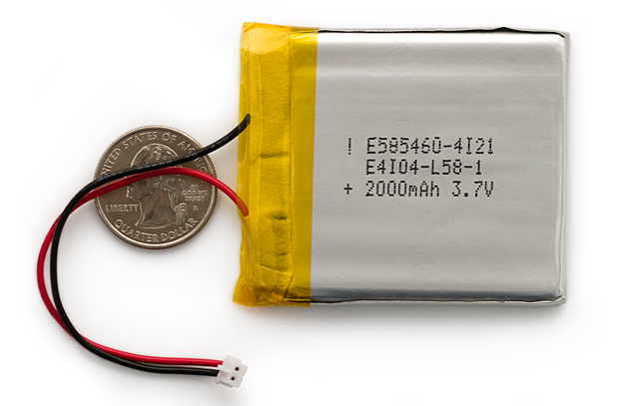
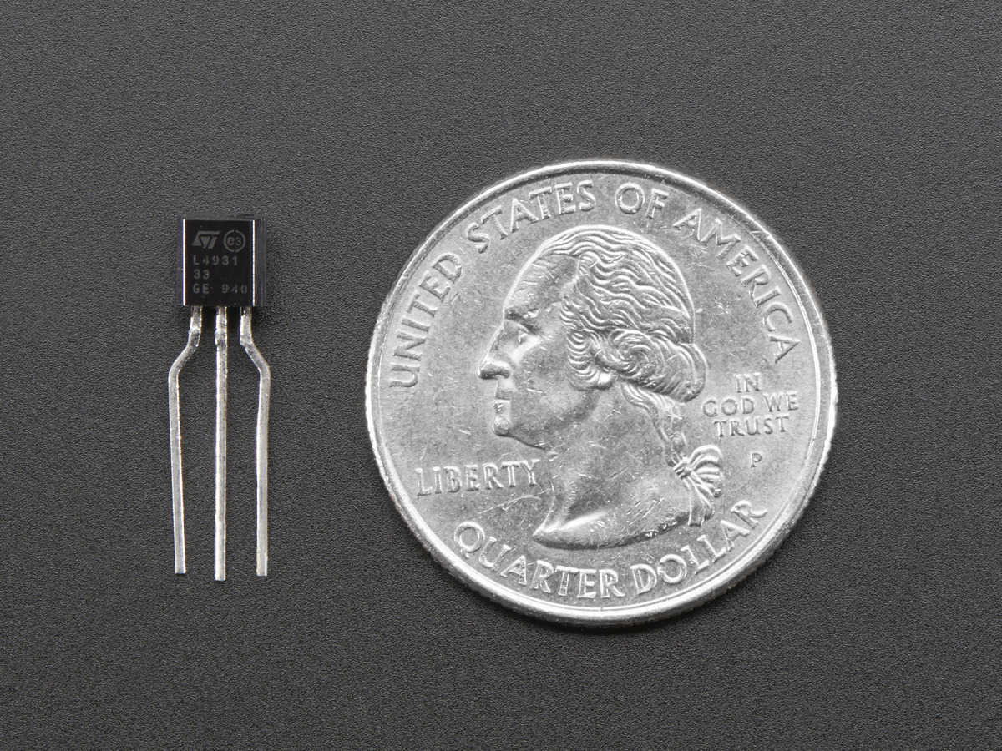
Significant Hardware Decisions - Battery & Regulators
Polymer Lithium Ion Battery - 2000mAh
3.7V at 2000mAh
Built-in protection against over voltage and over current
Self-discharge rate <8% per month
Regulators - TI LP2985
The purpose of voltage regulators is to keep a constant voltage level
Dropout Voltage: 0.4 V
Output Voltage: 3.3 V

Slide 10
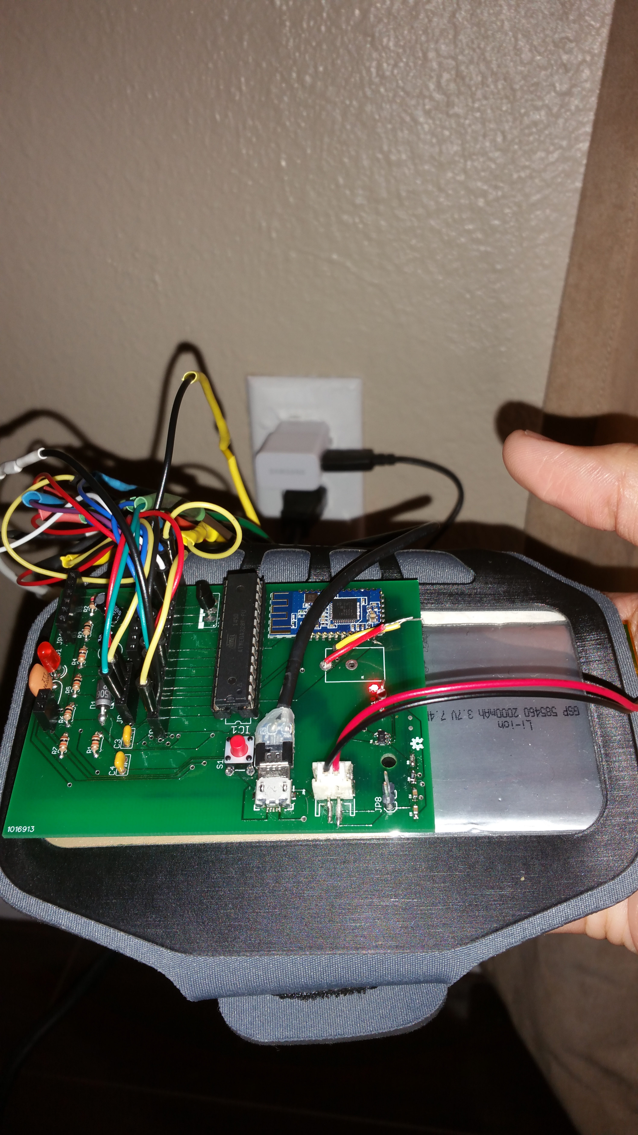
Significant Hardware Decisions - Charging
Charger input:
Micro-USB
Charge current 500mA
Charger output:
Single-Cell batteries Only
Lithium-Polymer or Lithium-Ion Only
Max Voltage: 4.2 V
Top challenges were:
Learning how to solder small electronics

Slide 11
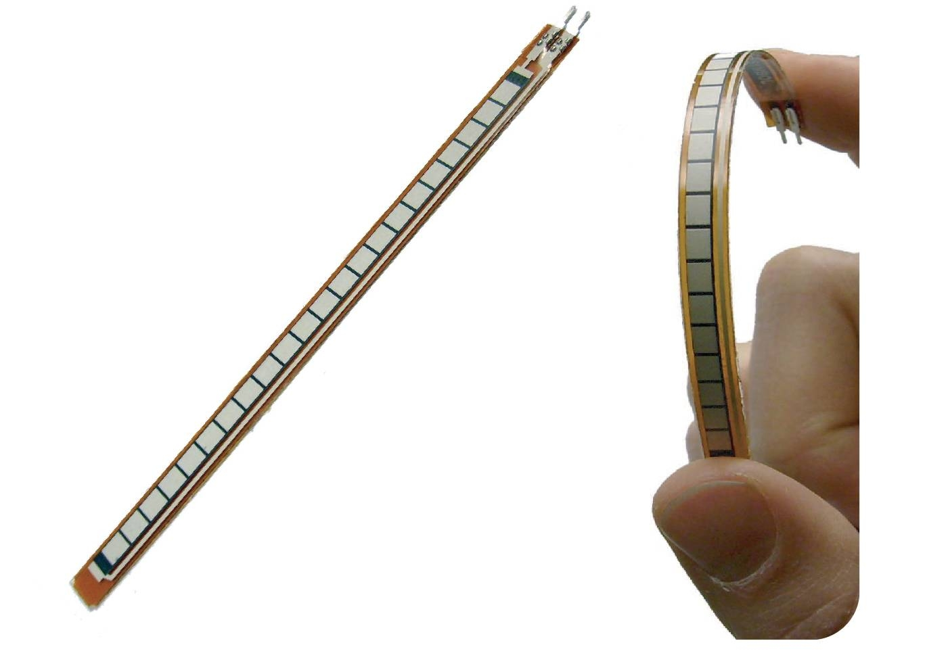
Significant Hardware Decisions – Flex Sensors
Flex sensors will be the primary sensors employed in this projects.
Flex sensors will be used to detect the degree to which each finger is bent on the hand performing the sign language gesture.
Each letter will have a specific configuration based on expected outputs of the five flex sensors.

Slide 12
Significant Hardware Decisions – Flex Sensors
SpectraSymbol Long Flex Sensor | Images Two-Directional Bi-Flex Sensor | Tactilus Flex
Pros: - widely available - accurate output | Pros: - built in pressure sensors | Pros: - claims high durability (>35 million cycles) - high quality leads
Cons: - fragile leads | Cons: - irregular shape - sold exclusively by manufacturer | Cons: - increased cost - sold exclusively by manufacturer

Slide 13
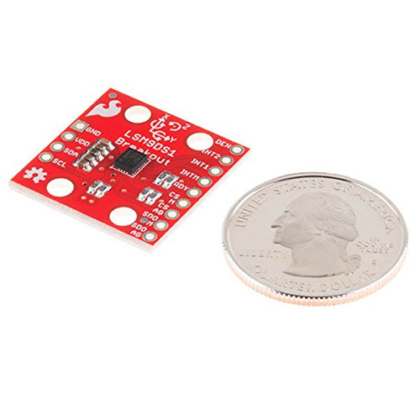
Significant Hardware Decisions – Gyroscope and Accelerometer
Accelerometers and gyroscopes can be used to measure these type of parameters, which are crucial in identifying certain sign language letters.
Examples include "j" and "z" or distinguishing between “g” and “q”.
The group is using the SparkFun 9 Degrees of Freedom IMU Breakout - LSM9DS1.

Slide 14
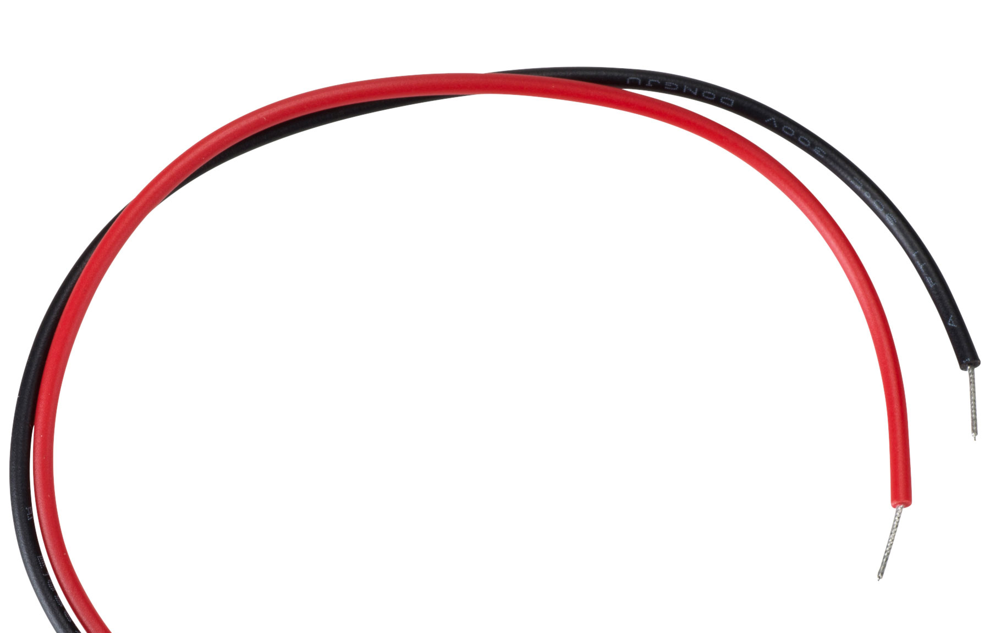
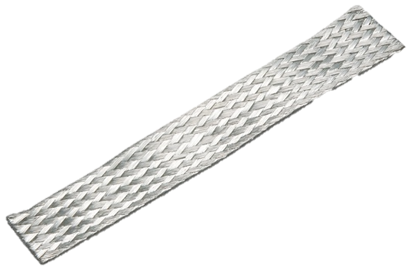
Significant Hardware Decisions – Contact Sensors
Contact sensors were crucial in telling apart the following pairs of sign language: R, U, and V, S and T and M and N.
The contact sensors were made with strips of copper braids that were connected to the power supply through wire leads.
The glove detects when two contact sensors come in contact creating a closed circuit.

Slide 15
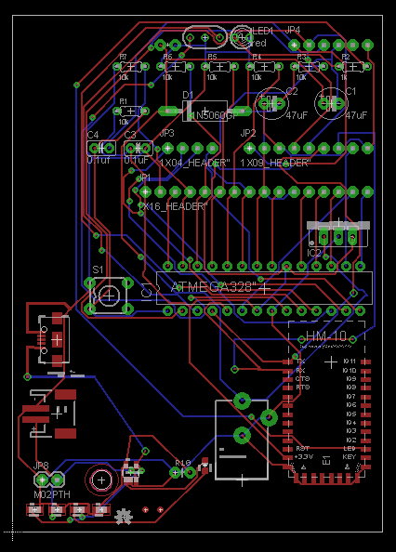
Significant Hardware Decisions – PCB
The PCB was designed using Eagle CAD software and fabricated by Bay Area Circuits and most parts were sourced from Digikey.com
It was designed as two layer board measuring 2.5” by 3.5” and is meant to be worn on the forearm.
Designing and building the PCB board was the biggest challenge with the hardware.
Top challenges were:
- Learning Eagle CAD
- Correctly Wiring Components
- Ordering the write components

Slide 16
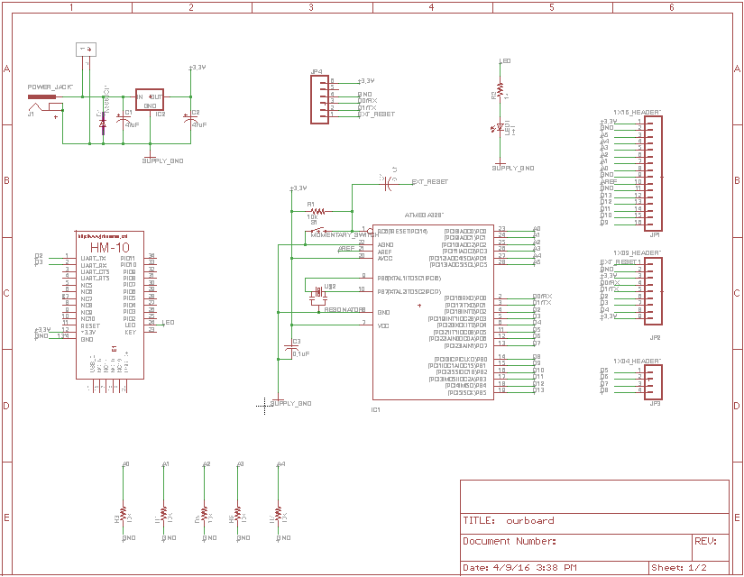
Significant Hardware Decisions – PCB

Slide 17
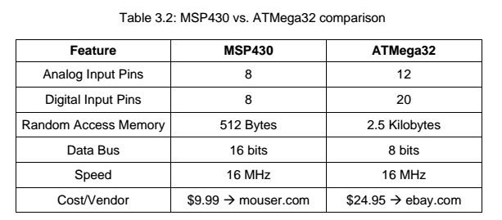
Significant Hardware Decisions – Microcontroller
The unit that is chosen will have to employ at least 6 analog input pins (with included ADC units), have digital i/o pins, and also be able to establish a line of serial communication.
When considering the microcontroller unit, it is also important to note that the two units come with their own native programming environments.

Slide 18
Gesture Recognition Software
The gesture recognition system will use thresholds to determine what hand gesture is being performed.
The ranges of values that are included in every type of hand gesture determine the minimum and maximum limits to the conditional statements.

Slide 19
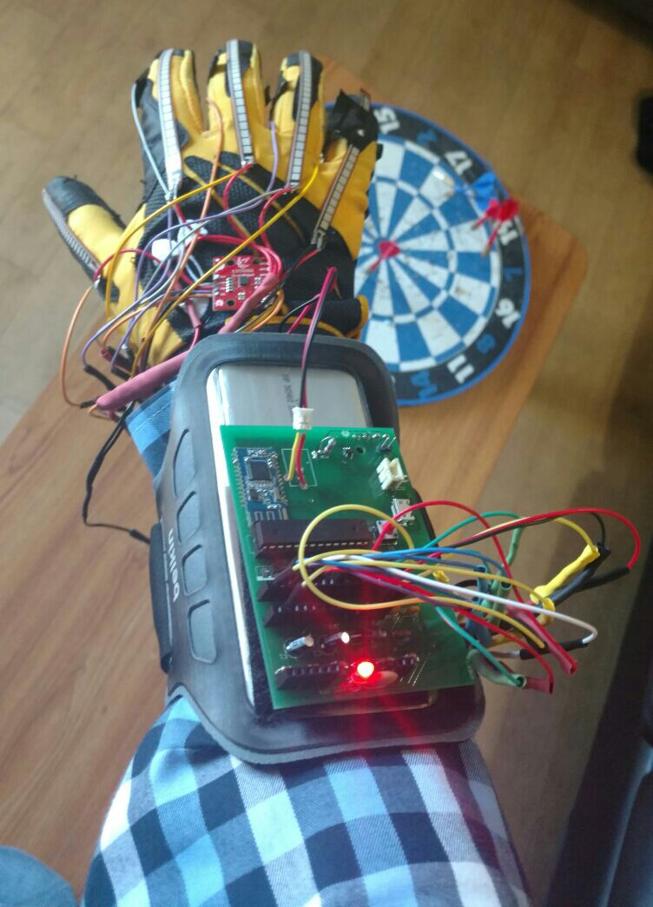
Calibration Process
The calibration process occurs during the ‘setup’ process of the program, before the infinite loop begins
Calibration will capture the minimum and maximum input values from each sensor, and apply the mapping function.
Calibration is needed because analog flex sensors provide volatile data that needs to be normalized.

Slide 20
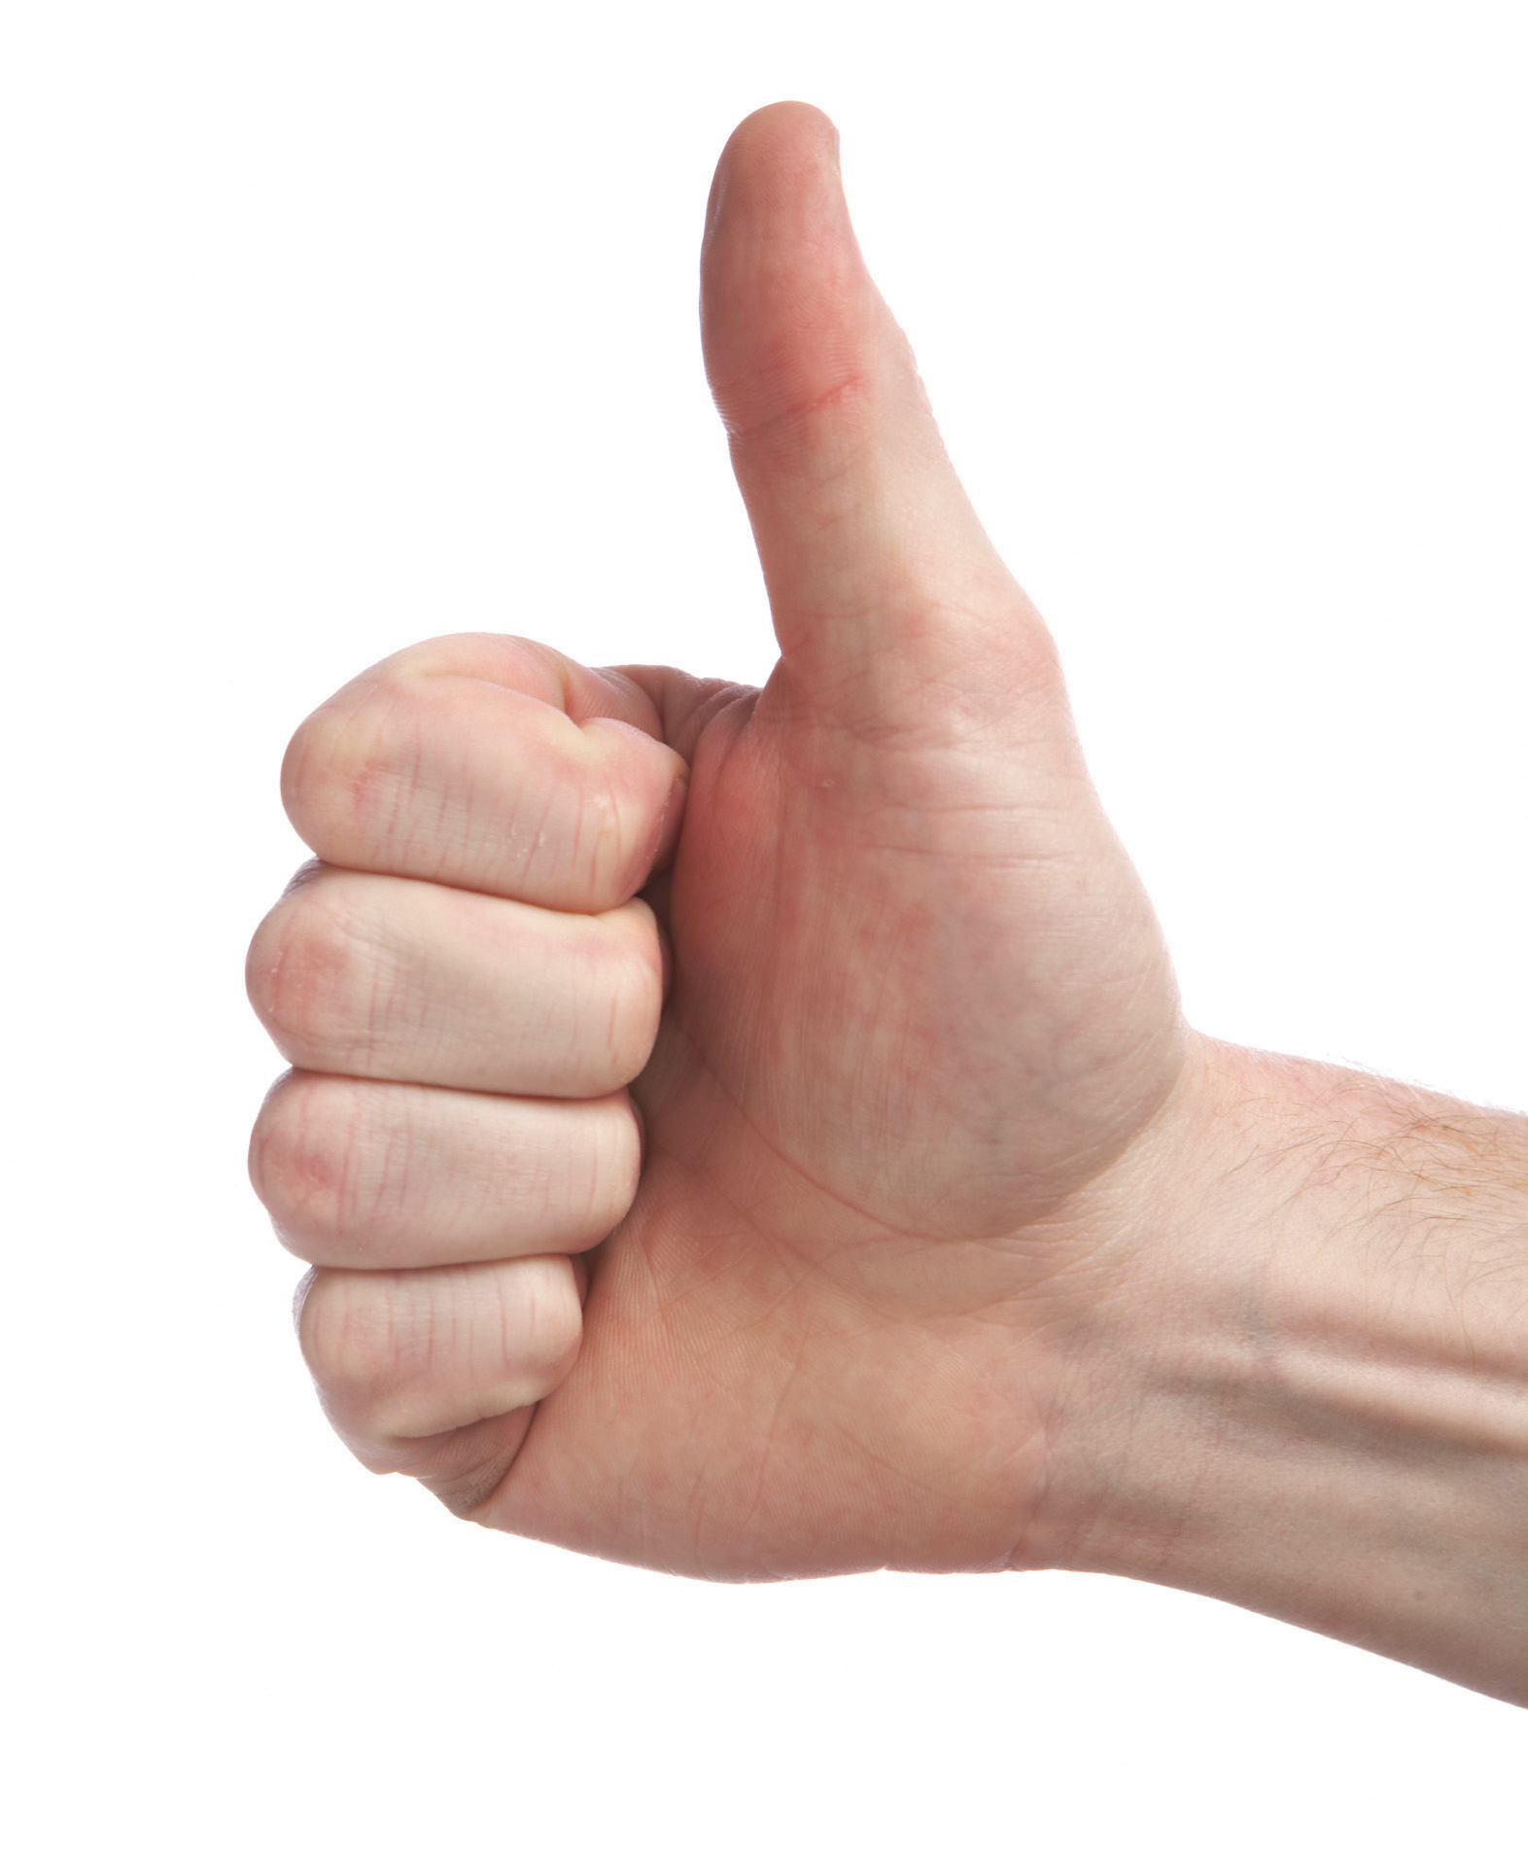
Gesture Recognition Software
Program scans sensors for data at one second intervals
Arduino “map” function is used to apply calibration
Normalized sensor values and motion data are used in conditional statements that determine gesture being performed

Slide 21
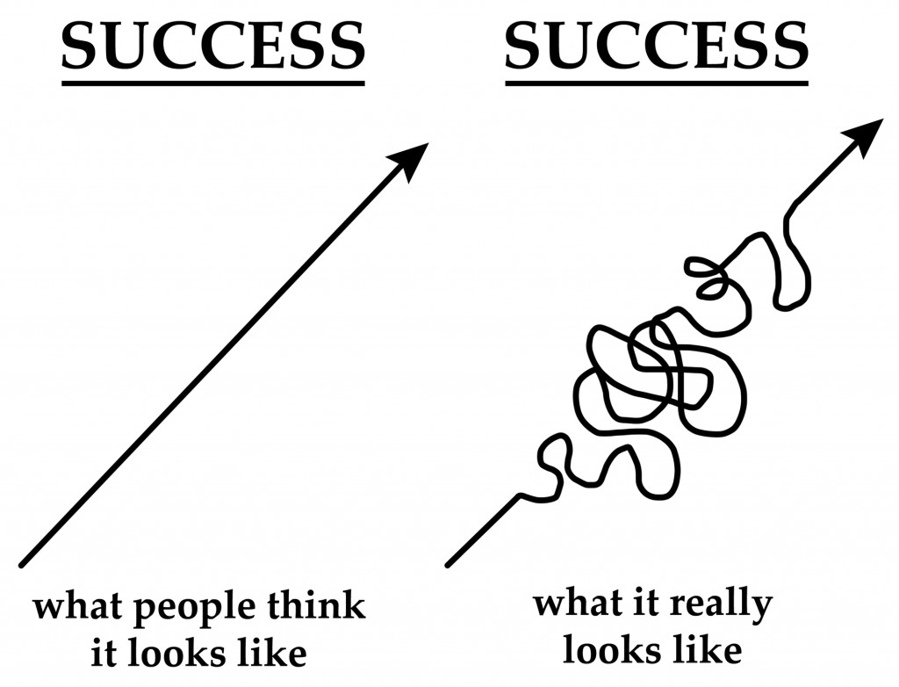
Gesture Recognition Set-Backs
Contact sensors needed to have internal pull-up resistors enabled due to floating i/o pins
Had to use SPI as opposed to I2C for the motion unit due to a lack of enough analog input pins
Many distinct gestures unexpectedly produced similar flex sensor data and required methods of distinction

Slide 22
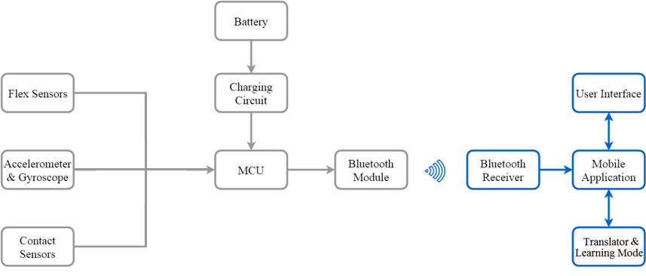
Software Components: Mobile Application

Slide 23
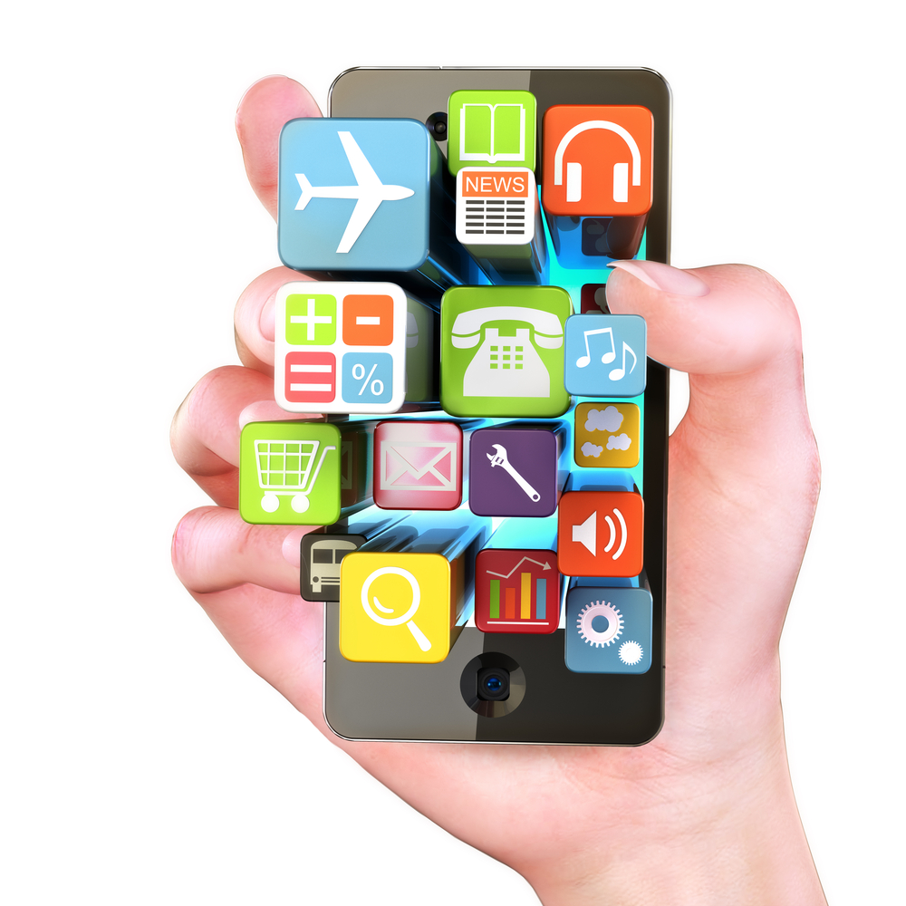
Mobile Application: Overview
The mobile application is an important feature of this project that will serve as the user interface for the sign language glove.
The mobile application is responsible for wirelessly displaying hand gestures performed by the glove onto a mobile phone screen as text.
In order for the mobile application to be successful, the design of the app should consider the user, be simple and elegant, and meet all design requirements.

Slide 24
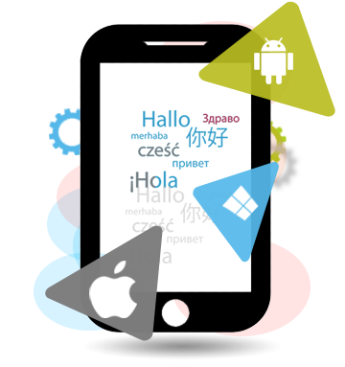
Potential Mobile Platforms
Android
Programming language: Java
IDE: Android Studio
Open source and cross-platform compatible
BLE compatible
Everyone in our group owns one!
iOS
Programming Languages: Swift or Objective-C
IDE: Xcode
Only Mac OS compatible
BLE compatible
Windows
Programming Languages: C++, C#, and Visual Basic
IDE: Visual Studio
BLE compatible

Slide 25

Android
Minimum Requirements
Device Type | Android
Mobile Platform | Smartphone
Bluetooth Version | Bluetooth Low Energy v4.0
Platform Version | Android 4.3
Codename | Jelly Bean-MR2
Android API Level | 18

Slide 26
Mobile App Flowchart

Slide 27
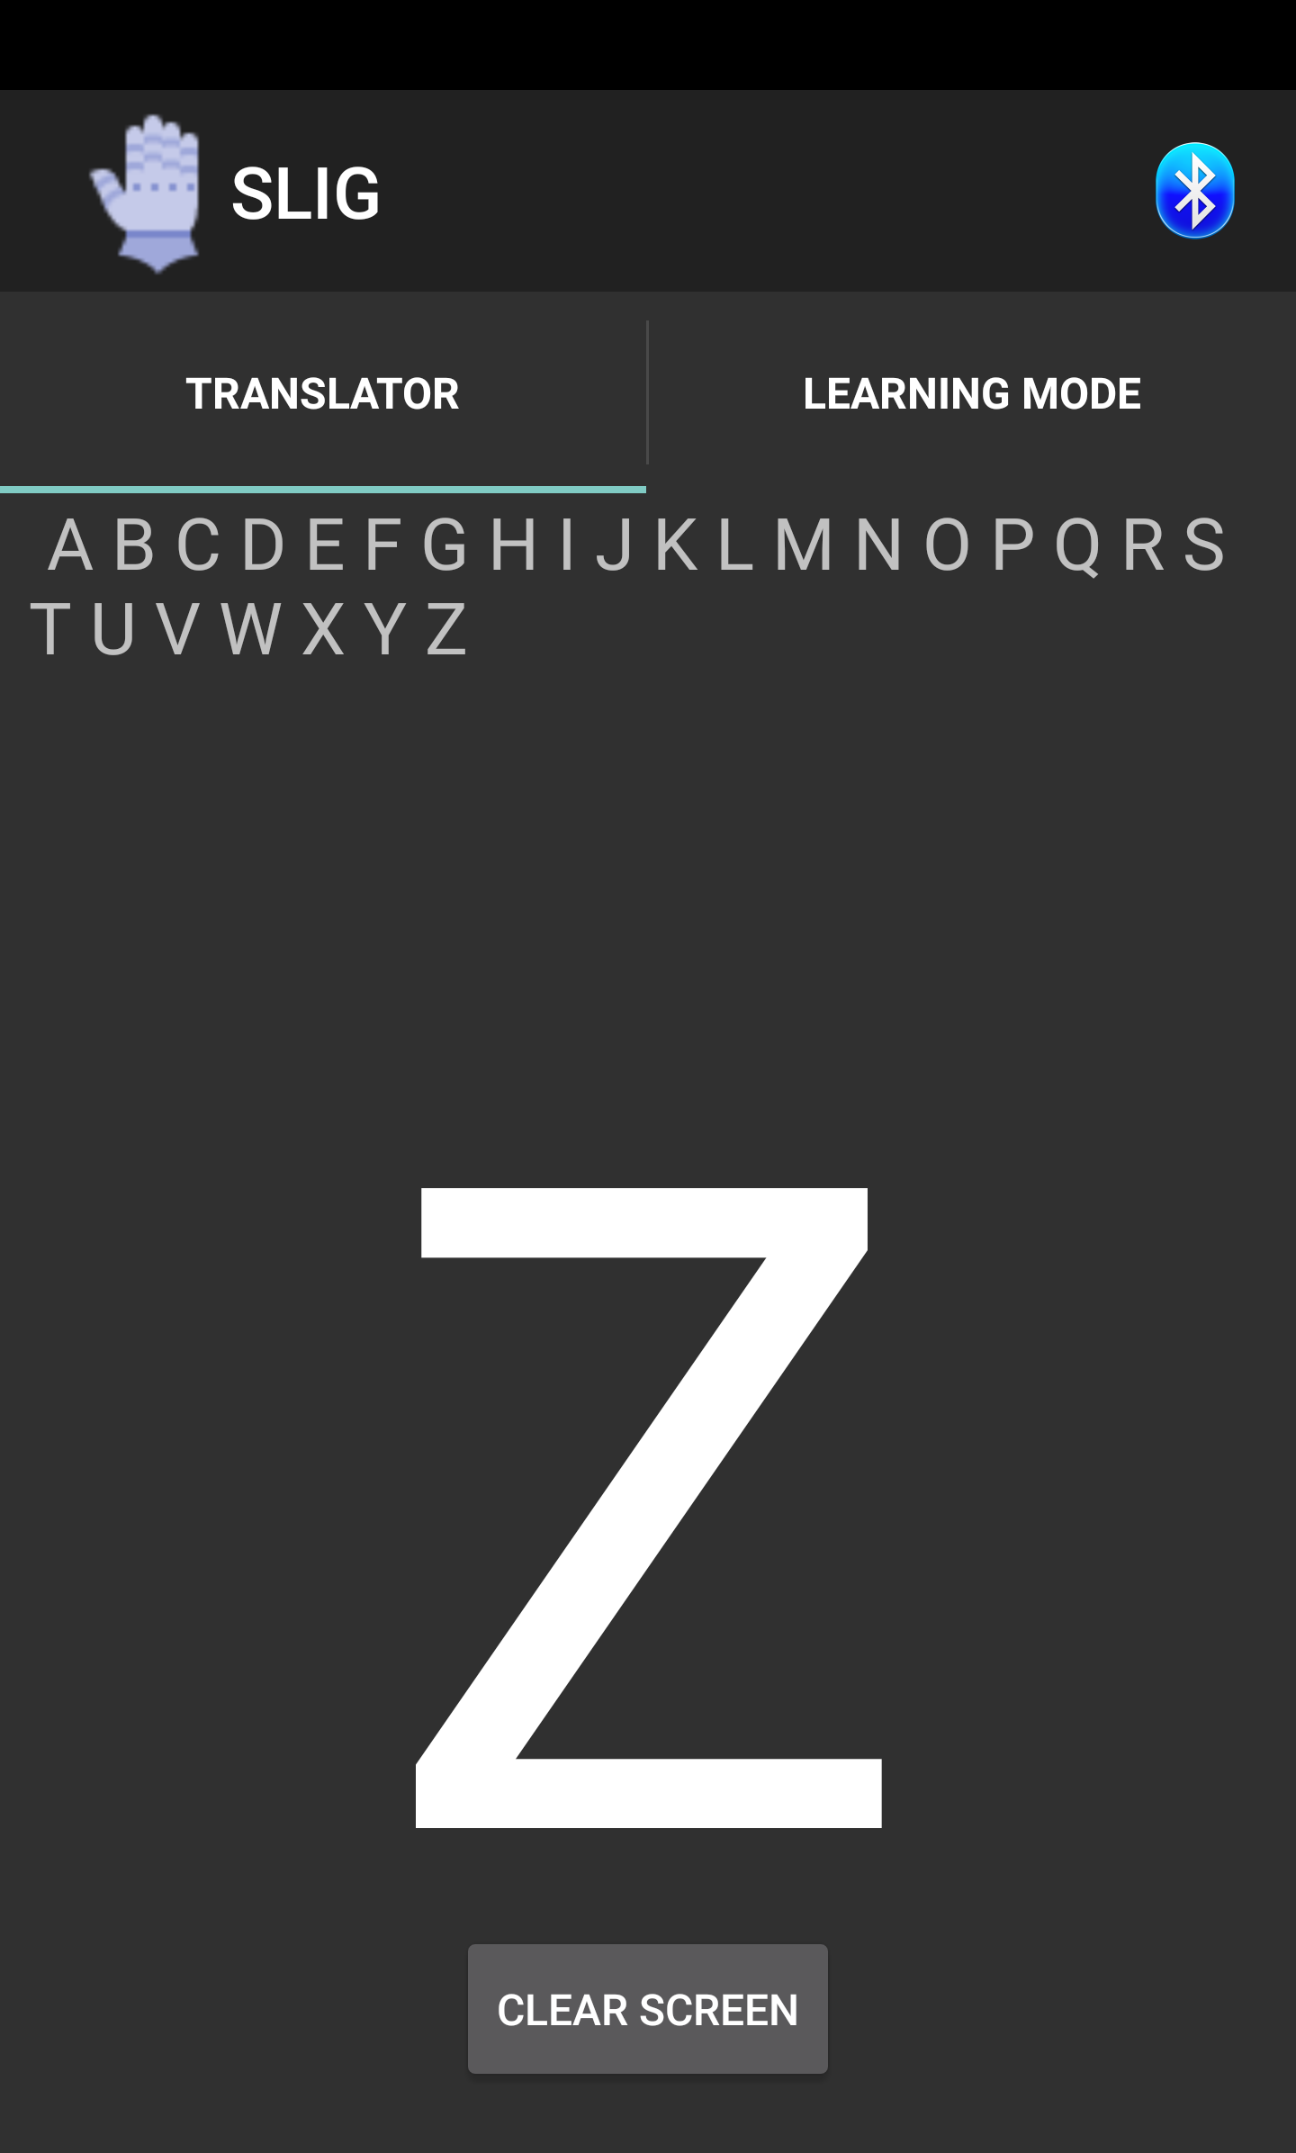
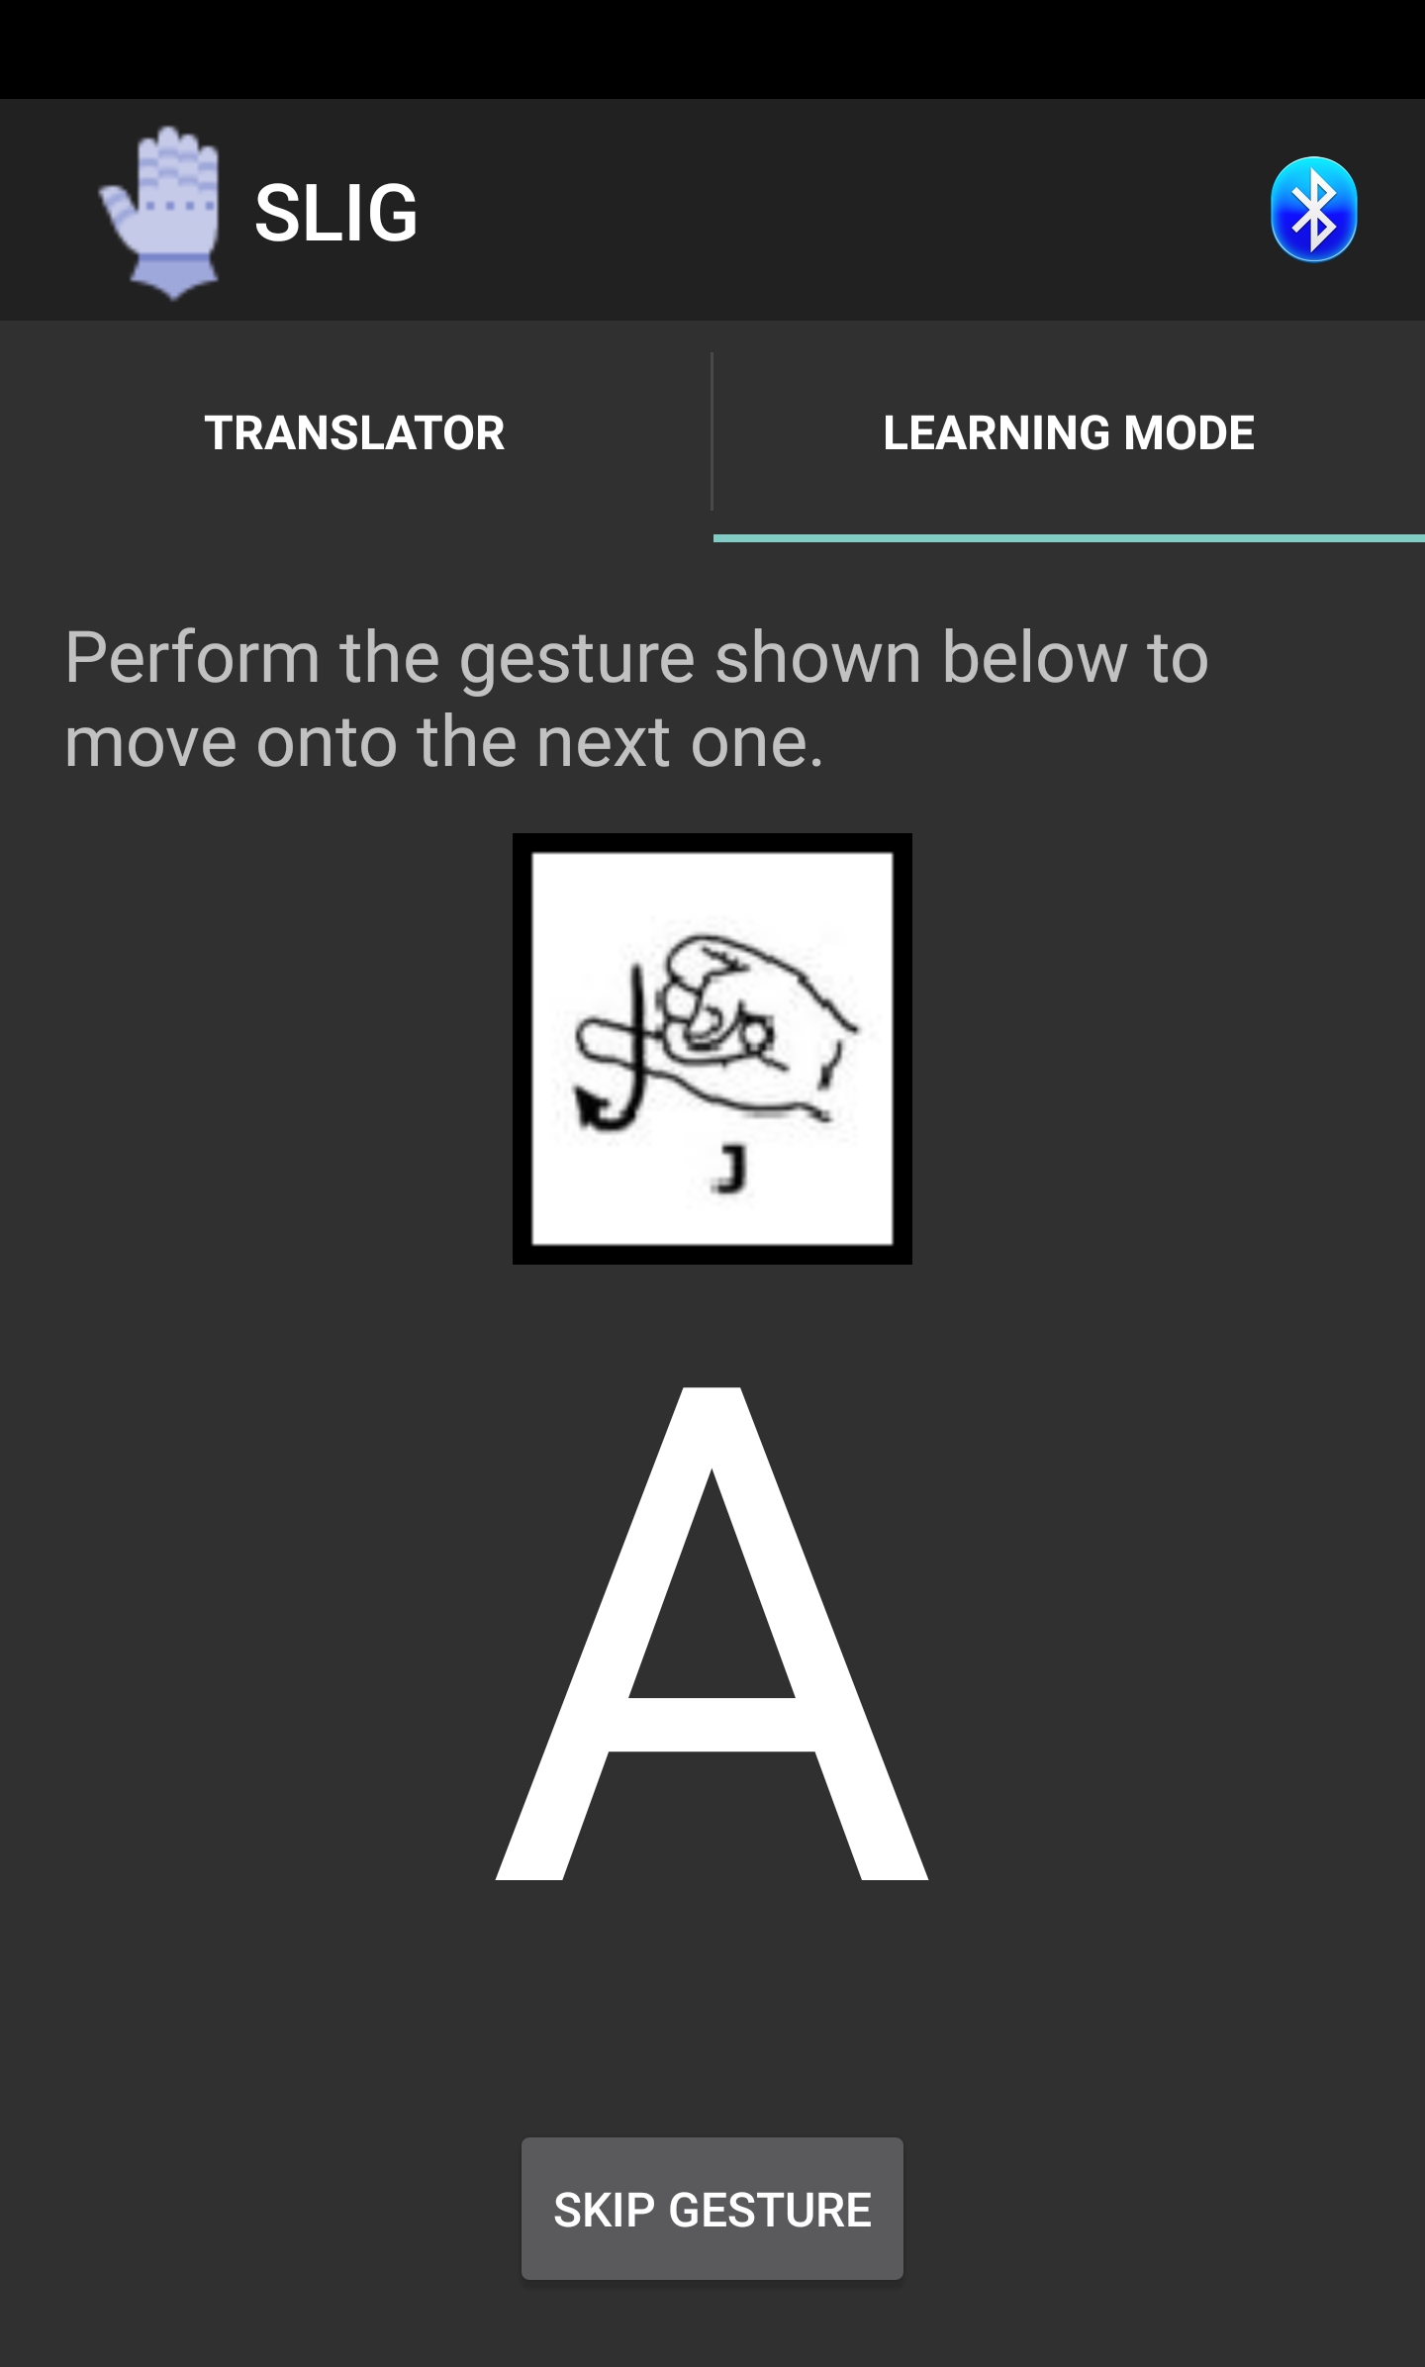
User Interface

Slide 28
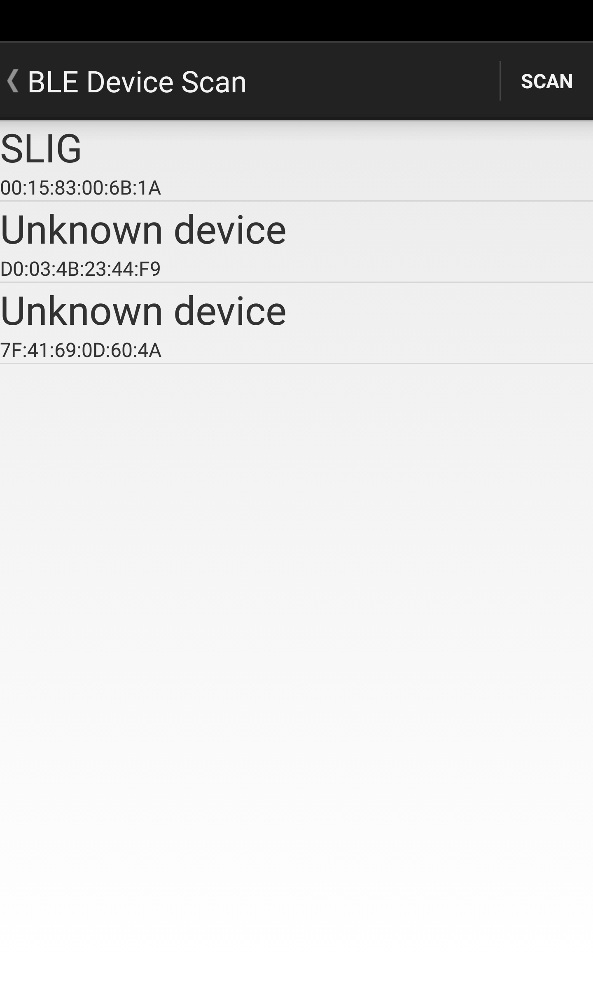
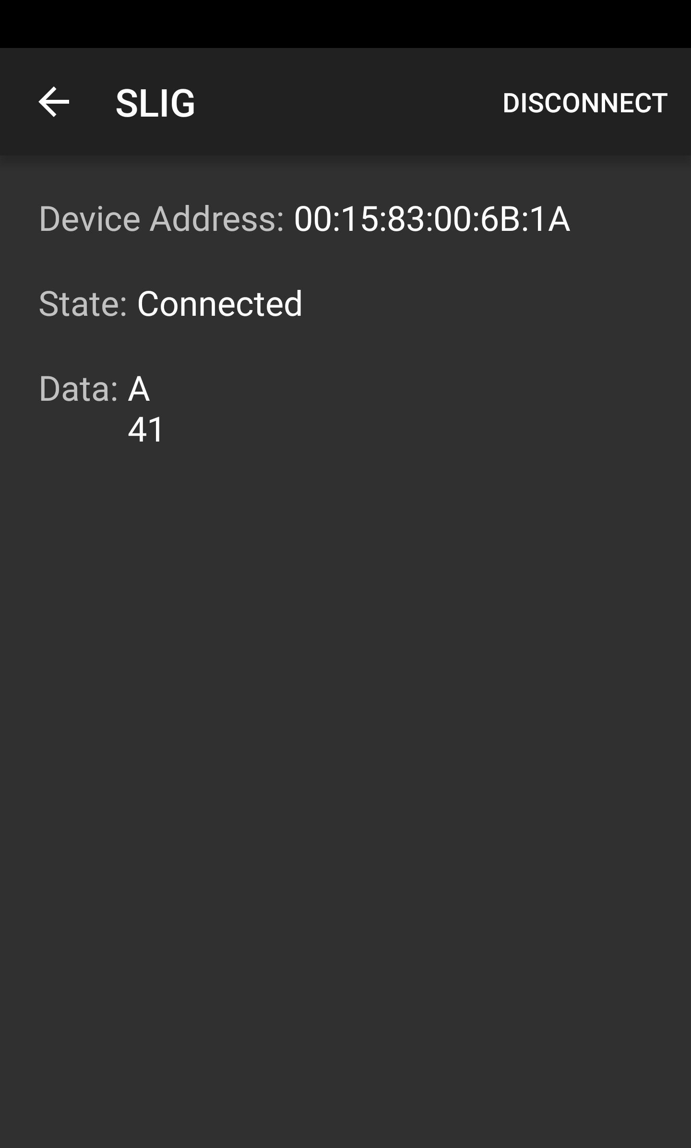
User Interface

Slide 29
Budget And Financing
Part Description | Price per Unit ($) | Quantity | Cost ($)
Flex sensors 4.5" | $12.95 | 15 | $194.25
Flex sensors 2.2" | $7.95 | 1 | $7.95
Development Board | $20.87 | 3 | $62.61
ATmega328P | $13.99 | 3 | $41.97
Bluetooth Module | $11.29 | 4 | $45.16
Accelerometer & Gyroscope | $29.55 | 2 | $59.10
Battery | $22.20 | 1 | $22.20
PCB | $49.60 | 1 | $49.60
PCB Components | $49.76 | 1 | $49.76
2nd PCB Components | $52.99 | 1 | $52.99
3rd PCB Components | $34.08 | 1 | $34.08
Glove and Wristband | $20.22 | 2 | $40.44
Glove and Armband | $45.00 | 1 | $45.00
Soldering Materials et al | $120.00 | 1 | $120.00
Total cost | - | - | 825.11
Boeing & Leidos sponsorship | - | - | $359.80
Difference |  |  | $465.31
Sponsored by: Boeing and Leidos
Initial Budget Estimate: $400
Final Project Cost: $825

Slide 30

Questions ?
#SLIG

